Slide 1

An overview of WRTDS and EGRET
Robert M. Hirsch
Research Hydrologist Emeritus
March 26, 2019

Slide 2
WRTDS (Weighted Regressions on Time Discharge and Season) is a statistical smoothing method for analysis of water quality data
EGRET (Exploration and Graphics for RivEr Trends) is an R package available from CRAN (current version is EGRET 3.0.2) it implements WRTDS and provides other exploratory analysis for water quality data and streamflow data
EGRETci is an R package for calculating confidence intervals and other uncertainty measures for WRTDS (current version is EGRETci 2.0.3)

Slide 3
Motivation for WRTDS & EGRET:
“The only way to figure out what is happening to our planet is to measure it,
and this means tracking changes decade after decade
and poring over the records.”
Ralph Keeling, 2008, Recording Earth’s vital signs, Science, p1771-1772

Slide 4
WRTDS overview
Data: Discrete concentration values (>100) plus daily discharge.
Builds a statistical model of concentration as a function of discharge, season, and year.
Uses this model to compute mean values & trends in concentration and flux.

Slide 5
WRTDS is designed to have these characteristics
Exploratory and quantitative (trends and mean values)
C vs Q relationship can change over time
Seasonal pattern can change over time
Temporal pattern of any shape, including non-monotonic
Results for both concentration & flux
Makes estimates of actual history & flow-normalized history
Handles censored data, “less-thans”
Handles non-stationary discharge history
Has been used to estimate frequency of exceedances
Reports the uncertainty of trend estimates

Slide 6
The thrill of victory, the agony of defeat
Water quality is highly flow-related
Assessements of progress can be easily obscured by the random, but persistent, patterns of wet and dry years
WRTDS uses “flow normalization” to deal with this problem

Slide 7

The thrill of victory

Slide 8
Look at the discharge record
Four dry years

Slide 9
The agony of defeat

Slide 10

It’s all about the flow!

Slide 11
Some might say, you can get rid of the problem if you just look at concentration rather than flux
Sorry to say, the problem remains

Slide 12
What’s my point here?
Although the history of loadings can be very useful to ecologists studying the drivers of the receiving water body,
It is not useful for assessing progress in the watershed.
We are smarter than Homer! We can deal with the influence of flow.

Slide 13
Data requirements
Requires a complete daily discharge record
Streamflow can’t be too flashy (low intra-day variability)
Works best with >100 samples
Water quality samples should cover most of the discharge range
For trends: 10 or more years of data
For average flux: 5 or more years of data

Slide 14
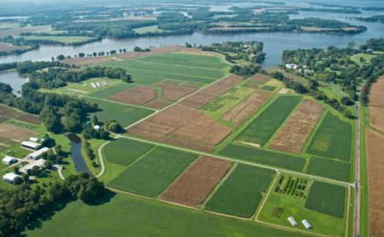
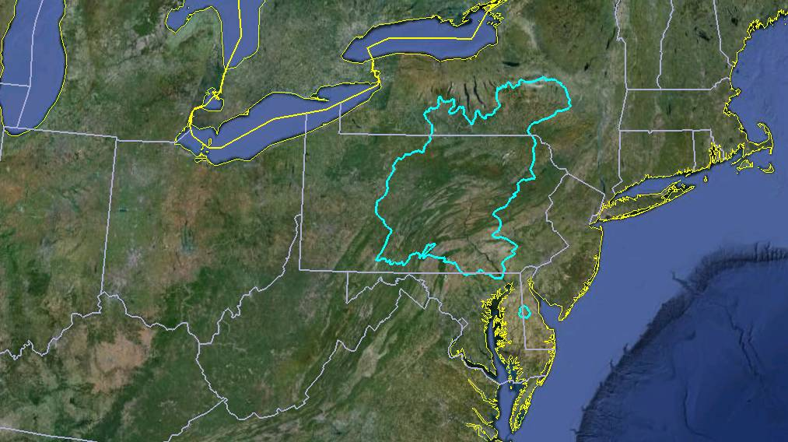
WRTDS Example
Choptank River, 293 km² watershed

Slide 15
“Data without models are chaos, but models without data are fantasy”
Nesbit, Dlugokencky and Bousquet, Science, 31 January 2014, pp. 493-495

Slide 16
Use the data and a simple, highly-flexible smoothing model to decompose the data into 4 components.
Discharge related component
Seasonal component
Time trend component
Random component

Slide 17
Locally Weighted Regression
For any location in time - discharge space (t and Q) we assume that concentration (c) follows this model
But the coefficients should be smoothly changing as we move through the space
Use weighted regression at many points in that space. The weight on each sample is determined by its “relevance” to that particular point in the space.

Slide 18
WRTDS view of the evolving behavior of nitrate
mg/L
How is this surface created?

Slide 19
Every dot is a data point from 1993 to 2012
Let’s say we want to use the data to estimate the expected value of concentration for January 1, 2003 at Q=500 cfs

Slide 20
Weights on each point are based on “distance” from January 1, 2003 at Q = 500 ft³/s
Distance in time, log(Q), and season

Slide 21
Tri-cubed weight function
Need a tri-cubed weight function here.
windowY -7 0 +7
windowQ -2 0 +2
windowS -0.5 0 +0.5

Slide 22
The overall weight for each observation is the product of the three individual weights.
Using the default values for the windows
The time weight is zero at > 7 years
The discharge weight is zero when | ln(Q) – ln(Q_{o}) | > 7
The season weight is zero when distance in time of year > 0.5

Slide 23
How do we set the weights for the regression?
These are the same points we just saw, but the radius of the dot is proportional to weight assigned to that point for purposes of estimating concentration for January 1, 2003 at Q=500 cfs
The weight depends on distance in: time, log discharge, and season from January 1, 2003 at Q = 500 cfs

Slide 24
Now, on to another point in the space.
For example an estimate for January 1, 2003 but for Q = 50 cfs
Redo the weights based on distance from that point and redo the regression

Slide 25
To organize the work, we make estimates for a mesh of points in this space.
14 Q values x 16 times per year for the period of record
In addition to estimates of E[C] we make estimates of E[ln(C)] and SE of ln(C)

Slide 26
This kind of weighted regression gets estimated about 6000 times to form this whole surface!!
You must be kidding. This is a ton of computations!!
That’s right! But it’s what we need to make order out of chaos.

Slide 27
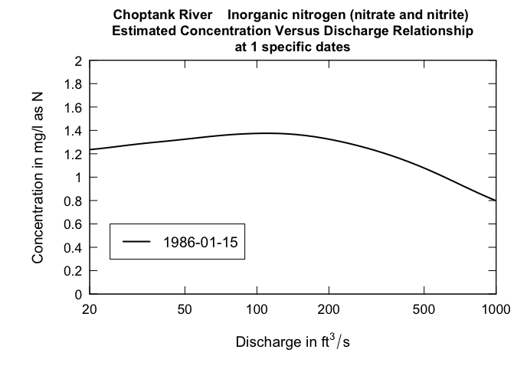
Let’s look at a single vertical slice of this surface

Slide 28
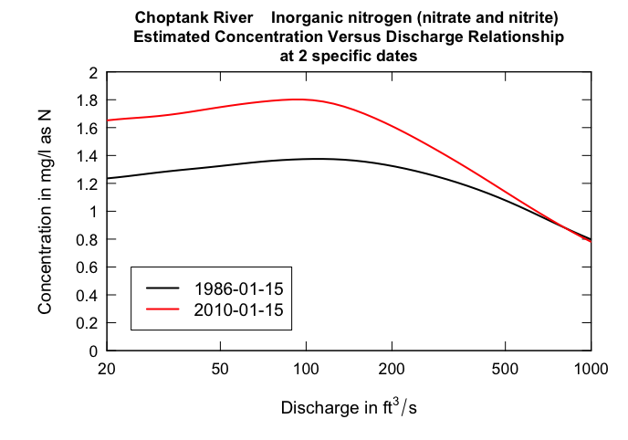
Let’s look at two vertical slices of this surface

Slide 29
We call them c vs. Q curves:
they can be highly non-linear and change shape over time:
No straight jacket

Slide 30
Another way to explore the change is by comparing two slices (in this case each is 2-years long)

Slide 31
Here are two, more detailed looks at this surface

Slide 32
Now, for every one of 10,227 days in the record from 1985 through 2012:
We can use the date and the observed discharge to compute the expected value of concentration.
From that value we can compute the expected value of flux.

Slide 33
Then we can sum these estimates by year to compute estimates of annual mean concentration & annual mean flux

Slide 34
A wet year
A dry year
Can we filter out this flow-driven variation to see the underlying change?

Slide 35
The “flow normalized concentration” on any given day is:
f(Q,T) integrated over the observed probability distribution of Q for that day of the year.
“Flow normalized flux” is just f(Q,T) x Q integrated the observed probability distribution of Q for that day of the year.
Sum those over the year to get annual flow-normalized mean concentration and flux.

Slide 36
Concentration trend +40% 1985-2012
Flux trend +27% 1985-2012

Slide 37
Look at changes in just the last few years.
This is a graphic of differences 2007 to 2012
mg/L
Hypothesis, cover crops are helping at higher flows particularly in the winter. Low flows are still responding to legacy of nitrate enriched groundwater.

Slide 38
Why all this complexity?
Different products for different purposes
Concentration versus flux
Actual history versus flow-normalized history

Slide 39
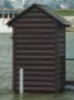
For understanding impact on the estuary ecosystem
Estuary
Watershed
Streamgage
& Sampling
Location
Tidal
River
We want the flux history

Slide 40
For understanding progress in the watershed
Estuary
Watershed
Streamgage
& Sampling
Location
Tidal
River
We want the flow-normalized flux history

Slide 41
For understanding the changes in the rivers
Estuary
Watershed
Streamgage
& Sampling
Location
Tidal
River
We want the concentration history

